Slide 1

A Central Europe investment opportunity analysis between Warsaw and Budapest
Federico Noverano
September 7, 2020

Slide 2
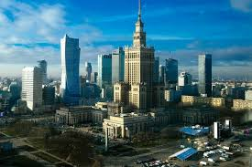
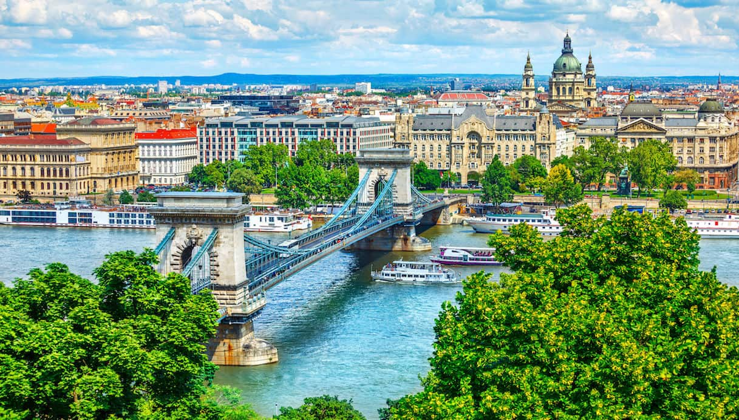
Business context
Italian food chain owing 5 restaurants in Warsaw, very successful due to online marketing messages, link to blogs/internet influencers, fashion newspaper, efficient cost structure and an high pricing point.
There is the possibility to get both EU and local funding for investing in Hungary, launching five restaurants in Budapest
Our company is requested to perform a similarity analysis between Warsaw and Budapest in terms of existing venues and distribution, to validate the idea
Warsaw
Budapest

Slide 3







Methodology and tools

Slide 4
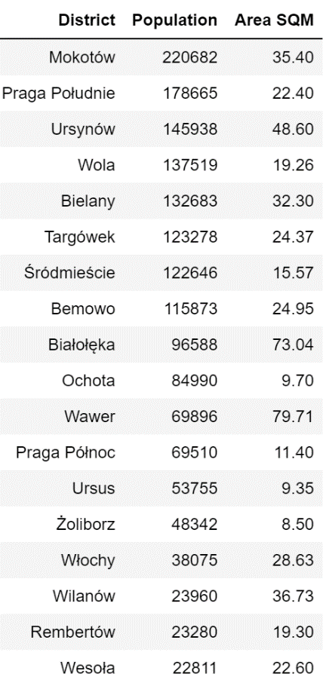
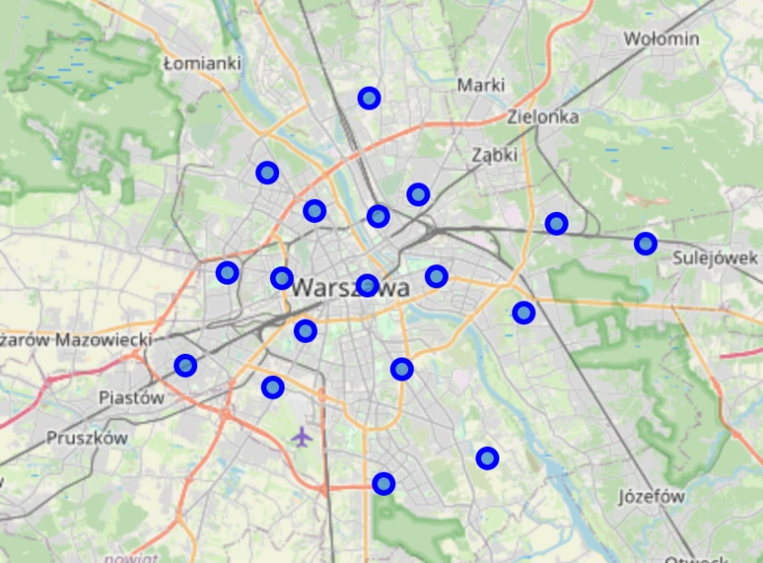
Warsaw Data Summary
The capital of Poland has 1,7 M inhabitants distributed in 18 districts, spanning over an area of about 522 km²

Slide 5
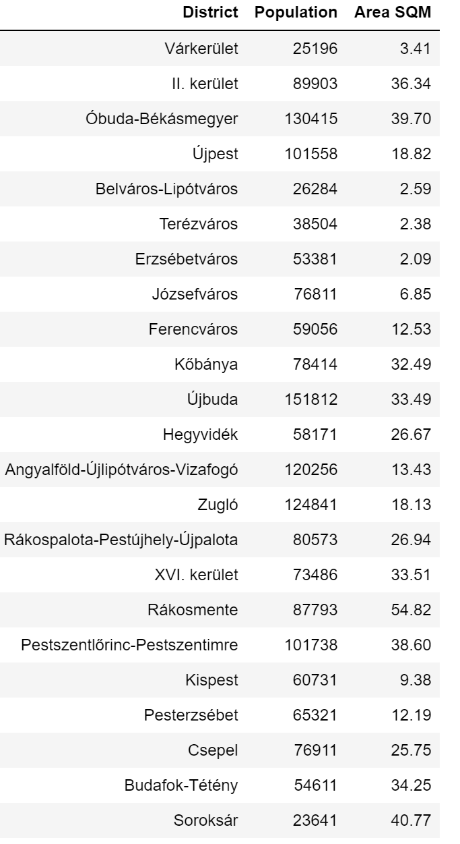
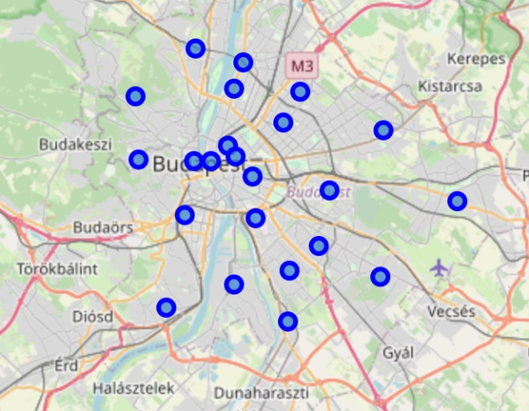
Budapest Data Summary
The capital of Hungary has 1,7 M inhabitants distributed in 23 districts, spanning over an area of about 525 km²

Slide 6
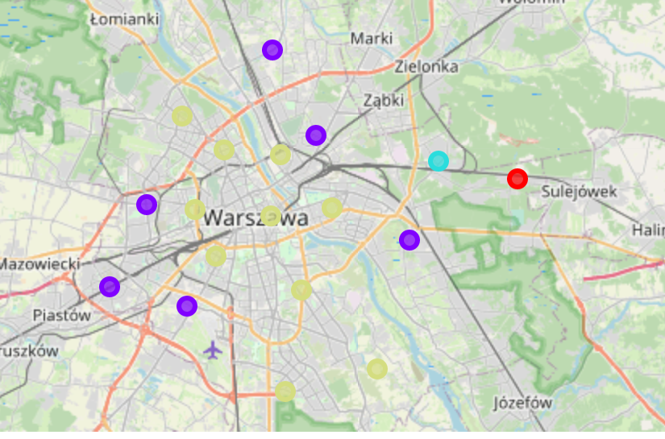
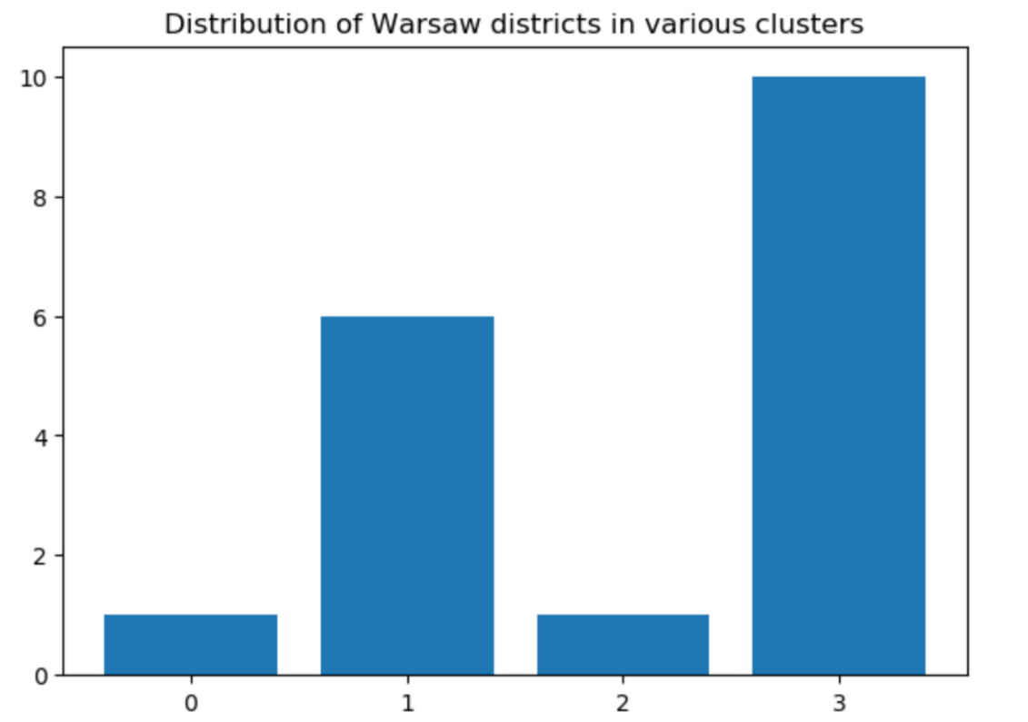
Warsaw districts clustering by venues
By applying K-means clustering with 4 clusters we observe the below distribution, two main clusters holds 16 districts, two remote district are irrelevant.

Slide 7
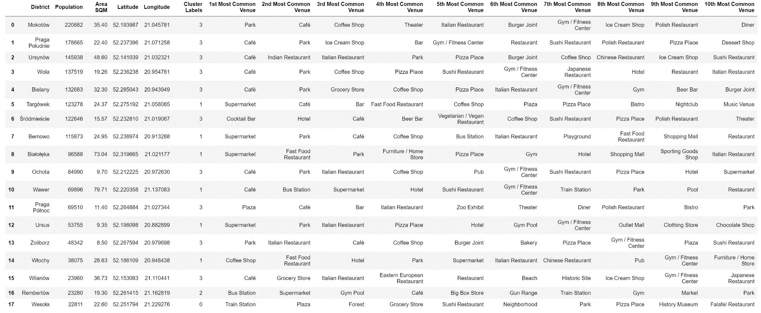
Warsaw top 10 venues per districts
A significant amount of high end attractions (restaurants, café, parks) in cluster 3, some lower level venues (groceries, supermarkets) il cluster 3

Slide 8
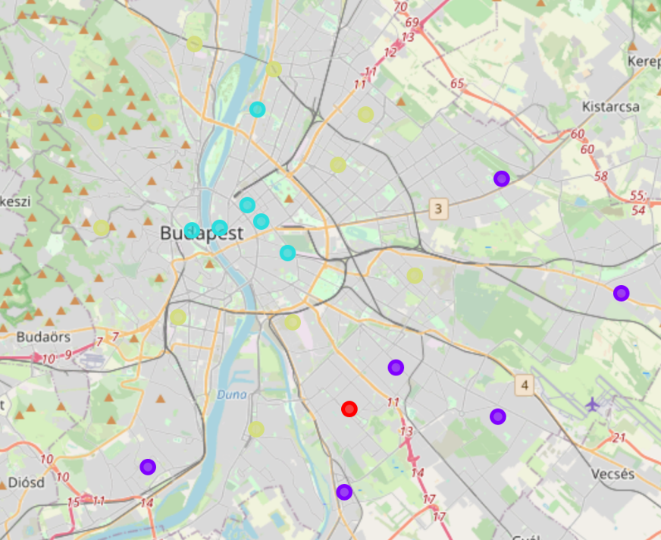
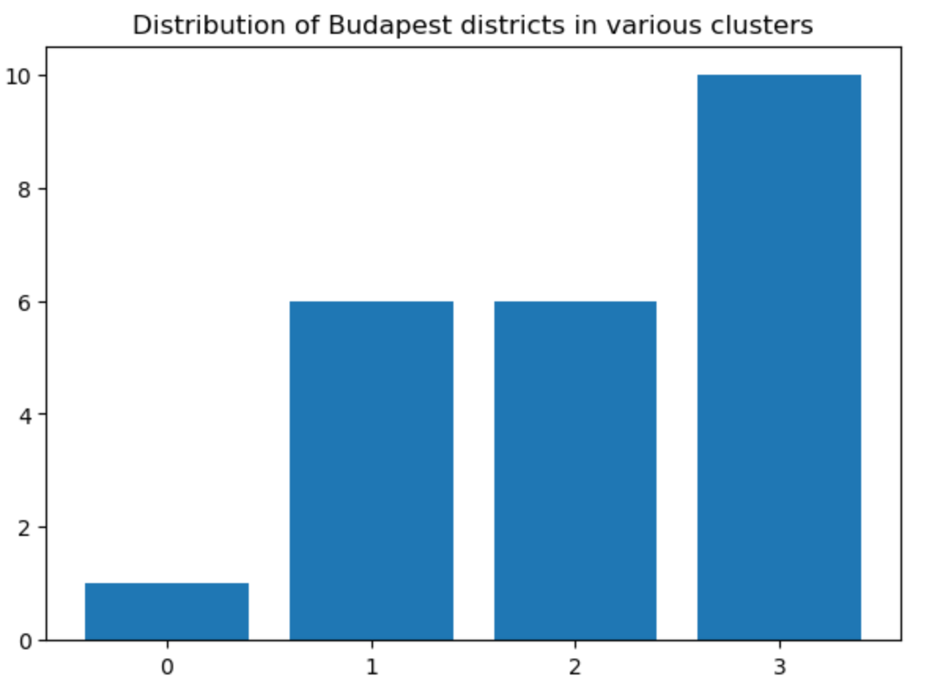
Budapest districts clustering by venues
By applying K-means clustering with 4 clusters we observe the below distribution, three main clusters holds 21 districts, the city is clearly split in three tiers proceeding with distance from city center.

Slide 9
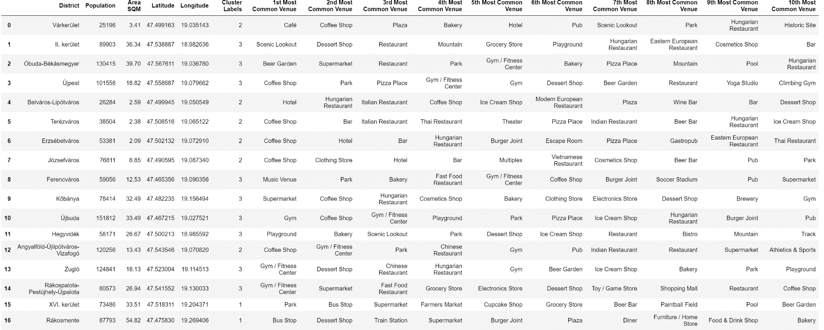
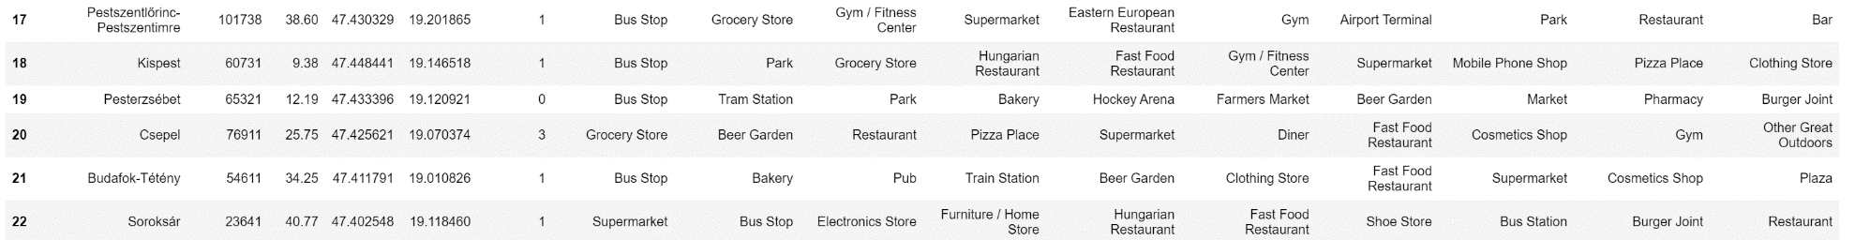
Budapest top 10 venues per districts
the most attracting venues, are concentrated in clusters 2 and 3, whilst in cluster 1 there is a far share of public transport and some lower-end venues like groceries, so those are typically areas for lower income people

Slide 10
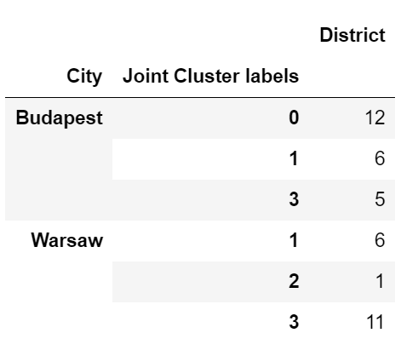
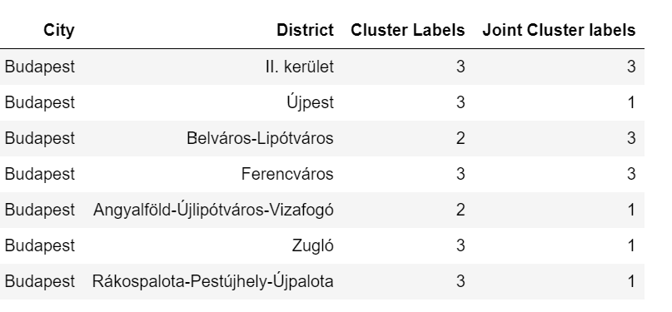
Warsaw and Budapest comparison
After performing a 4 class clutering with districts venues from both cities we have been able to identify what districts of Budapest are more similar to Warsaw ones
Looking at previous clustering and joint clustering outcomes we can see that the most promising areas from Budapest are the ones which are clustered together with the Warsaw districts previously assigned to the richest Warsaw cluster

Slide 11
Results summary
Based on the initial data collected, the geographical and venue analysis of Warsaw and Budapest confirm some nice similarity among the two cities:
a large set of venues of different kind
a concentration of wealth in the central area and similar type of attractions
a pretty clear distinction between the city center/wealthier areas and areas which are more a kind of dormitory for low income people
Given the identified similarity we are well encouraged to suggest our client to proceed with the investment in Budapest, furthermore the joint clustering exercise has identified which are the more promising area of Budapest to consider the opening of new restaurants given both their localization in the highest end of Budapest living as well as their similarity with Warsaw districts from cluster where the previous investment was successful.

Slide 12
Conclusion and next steps
Based on the performed analysis we are going to recommend to proceed with the investment in opening a new set of restaurant in Budapest, however to fine tune the exact localizations starting from the shortlist of proposed districts we would suggest to perform additional statistical analysis, leveraging appropriate machine learning algorithms of the following kind of data:
presence of people in the various areas at different time of the day
more detailed analysis of target group being Hungarian residents, as well as foreigners (tourism in Budapest is definitely much more relevant than in Warsaw)
analysis of economic growth in Hungary perspective in the longer term and comparison with similar data from Poland
Is also worth suggesting some analysis of the political situation and monetary policy in Hungary in order to mitigate risks deriving from import/export regulation, currency fluctuation, legislation benefits or barriers from foreign investments.

